Slide 1

MAZE TECH
YOUR COMPREHENSIVE TECH SUPPORT, ALL IN ONE PLACE
WWW.MAAZE.TECH

Slide 2
CONTENTS
What You'll Discover
01
Who We Are
02
Our Services
Discover Maze Tech's story, mission, and our commitment to transforming businesses
From IT infrastructure to AI automation, explore our comprehensive solutions
03
Why Choose Us
04
Get in Touch
The numbers and values that set us apart in the technology industry
Ready to transform your technology? Let's start the conversation

Slide 3

01
Who We Are
Discover the story behind Maze Tech and our mission to transform businesses through technology

Slide 4
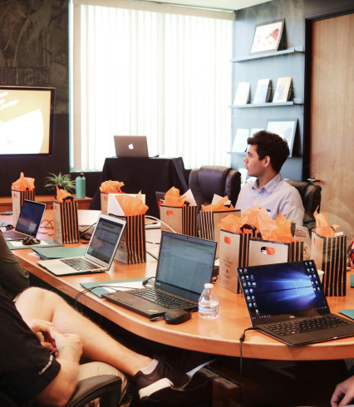
About Maze Tech
Maze Tech is a comprehensive technology solutions provider based in Cairo, Egypt, with operations spanning Saudi Arabia and the Middle East.
We empower companies with innovative digital solutions that boost performance, streamline operations, and drive sustainable growth.
Our team of technical specialists delivers end-to-end IT services from consultation to implementation and ongoing support.
9+
2
Service Categories
Countries Operating

Slide 5

02
Our Services
From IT infrastructure to software development, cybersecurity to AI automation - we cover all your technology needs

Slide 6
IT Solutions & Management
IT Infrastructure
Networks, servers, support and monitoring
IT Project Management
From planning to delivery, we manage it all
IT Consulting & Support
Strategic guidance and 24/7 technical support

Slide 7

Software Development
Web Development
Mobile App Development
Responsive, secure, and SEO-optimized websites
Cross-platform apps for iOS and Android
UI / UX Design
Custom Applications
Modern, user-friendly interfaces
Tailored software for your business needs

Slide 8

Cloud & Cybersecurity
Cloud Solutions - Secure, scalable cloud hosting and infrastructure management. Cloud migration and DevOps automation services.
Cybersecurity - Advanced data protection and vulnerability management solutions that safeguard your critical assets.
Cloud Migration & DevOps
Modernize operations with cloud infrastructure
Advanced Security Solutions
Data protection and threat management

Slide 9

AI, Automation & Call Centers
Automate workflows and boost efficiency with smart AI systems. Our AI-driven contact center solutions empower your customer service operations.
1M+
99%
200+
Calls Handled Annually
Customer Satisfaction
Skilled Agents
Our Call Center Solutions provide 24/7 maintenance and troubleshooting to keep your systems running. With years of experience in outsourced call center management, we elevate your customer engagement strategies.

Slide 10

03
Why Choose Us
The numbers and values that set us apart in the technology services industry

Slide 11
OUR IMPACT
Numbers That Speak
1M+
99%
200+
Calls Handled Annually
Customer Satisfaction
Skilled Agents
9+
2
6/7
Service Categories
Countries Operating
Days Availability
Schedule a consultation for a free assessment of your technology needs

Slide 12
Business Applications Solutions
We specialize in ERP, CRM and custom business applications using leading platforms. Our solutions streamline your processes, improve customer relationships, and drive operational efficiency.
ERP Solutions
CRM Solutions
Custom Apps
Enterprise resource planning on Odoo, Microsoft Dynamics
CRM solutions with Zoho and Salesforce
Tailored applications built for your unique workflows
Powered by industry-leading platforms: Odoo | Microsoft | Zoho

Slide 13
04
Get in Touch
Ready to transform your technology infrastructure? Let's start the conversation

Slide 14
Let's Build the Future Together
Contact us for a free consultation
Email: info@maaze.tech
Phone: +966 56 960 0661 | +201145173691
Address: 306 St Park, Etisalat, Cairo Maadi
FOLLOW US
WWW.MAAZE.TECH
Copyright © 2025 MAZE TECH. All rights reserved.

